Slide 1




LEARN IT
FOR TECHNOLOGICAL EDUCATION

Slide 2

Back-End ASP.Net BootCamp

Slide 3
Session 1 . C#

Slide 4
Contents of the presentation
Introduction to .NET
What is .NET?

Slide 5
Contents of the presentation
Understanding the .NET ecosystem
Difference between .NET & .NET framework

Slide 6
Contents of the presentation
Introduction to C#
Variables & Data Types

Slide 7
Contents of the presentation
String Manipulation
Using The var Keyword

Slide 8
Contents of the presentation
Operators
Conditional statements

Slide 9
Introduction to .NET
What is .NET?
.NET is a modern, open-source, cross-platform framework developed by Microsoft for building a wide variety of applications. It allows developers to create applications for different platforms like Windows, macOS, and Linux using a single codebase. .NET is used to build everything from web and mobile applications to desktop software, cloud-based services, microservices, gaming, and more

Slide 10
Introduction to .NET
Key Features of .NET:
1- Cross-Platform: .NET can be used to build applications that run on Windows, Linux, and macOS. This makes it a versatile platform for different types of projects across different environments.
2- Open Source: .NET is open-source and available for free. Its source code is hosted on GitHub, allowing develyopers to contribute to its improvement.
3- Languages: .NET supports several programming languages, the most common of which are:
C# (the most widely used)
F# (functional programming)
Visual Basic (VB.NET)

Slide 11
Introduction to .NET
Key Features of .NET:
4- Application Types:
- Web applications (using ASP.NET Core)
- Mobile applications (using Xamarin or .NET MAUI)
- Desktop applications (using WinForms, WPF, or .NET MAUI)
- Cloud applications (integrated with Azure)
- Microservices (using Docker, Kubernetes, etc.)
- Gaming (through Unity game engine integration)
5- Performance: .NET is known for its high performance, with frequent improvements to speed, memory usage, and overall efficiency.

Slide 12
Introduction to .NET
Understanding the .NET ecosystem
The .NET ecosystem is a comprehensive environment for building all types of applications. It includes:
1- The .NET Platform (cross-platform, open-source framework for building applications)
2- Programming Languages (C#, F#, and VB.NET)
3- Frameworks for web, mobile, desktop, and cloud apps (ASP.NET Core, Blazor, .NET Multi-platform App UI
, etc.)

Slide 13
Introduction to .NET
Understanding the .NET ecosystem
4 - Development Tools (Visual Studio, Visual Studio Code, NuGet)
5- Cloud Integration (Azure, Docker, Kubernetes)
6- Data Management (Entity Framework, SQL Server, CosmosDB)
7- Microservices & APIs (gRPC, Web API, SignalR)
8- Testing & DevOps (xUnit, Azure DevOps, GitHub Actions)
The ecosystem is powerful, scalable, and continues to evolve, offering developers the tools to build high-performance, cross-platform, and cloud-native applications.

Slide 14
Introduction to .NET
What is the difference between .NET & .NET framework?
The terms .NET and .NET Framework are related but distinct. Here’s the key difference:
1. .NET Framework:
- Platform: Windows-only
- Development Focus: Primarily desktop and web apps on Windows
- Open Source: No (closed-source)
- Versioning: Latest is 4.8 (no more new major versions)
- Performance: Lower compared to .NET Core/5+
- Cross-Platform Support: No, only Windows
- Mobile Development: No, only Windows

Slide 15
Introduction to .NET
What is the difference between .NET & .NET framework?
The terms .NET and .NET Framework are related but distinct. Here’s the key difference:
2. .NET (Core and Beyond):
- Platform: Cross-platform (Windows, macOS, Linux)
- Development Focus: Web, mobile, desktop, cloud, microservices
- Open Source: Yes (open-source, hosted on GitHub)
- Versioning: .NET 5, .NET 6, .NET 7, .NET 8 (actively developed)
- Performance: Higher performance, optimized for speed
- Cross-Platform Support: Yes, runs on multiple operating systems
- Mobile Development: Supported via Xamarin and .NET Multi-platform App UI

Slide 16
Introduction to C#
C# (pronounced "C-sharp") is a modern, object-oriented programming language developed by Microsoft as part of its .NET framework. It was created by Anders Hejlsberg and first released in 2000. C# is designed to be simple, powerful, and flexible, making it one of the most widely-used programming languages, particularly for Windows development, but also for cross-platform development (thanks to .NET Core and .NET 5+).
Here’s an example of a simple C# program:
using System;
class Program
{
static void Main()
{
// Declaration of variables
int number1 = 10;
int number2 = 20;
int sum = number1 + number2;
// Displaying output
Console.WriteLine("The sum of " + number1 + " and " + number2 + " is: " + sum);
}
}

Slide 17
Introduction to C#
Lets Setup the Tools

Slide 18
`
Introduction to C#
Key Components:
using System; : This imports the System namespace, which contains essential classes like Console.
class Program: Defines a class named Program (every C# application must have at least one class).
static void Main(): The entry point of the application. This is where the program starts execution.
Variables: int is a data type, and variables (number1, number2, sum) hold data.
Console.WriteLine: A method to print output to the console.

Slide 19
`
Variables & Data Types
Data types define the type of data a variable can hold.
A variable is a named storage location that holds a value, and each variable has a specific type that determines what kind of data it can store.
C# offers two main types of data types:
1- Value Types
Value types hold the actual data directly. When you assign a value type to another variable, it creates a copy of the value. Value types are stored on the stack (in memory) for performance reasons.

Slide 20

`
Variables & Data Types
Common Value Types:
1- Numeric Types (32 bit = 4,294,967,296)
- int: Represents a 32-bit signed integer (e.g., 123, -456).
- long: Represents a 64-bit signed integer (e.g., 12345678901234L).
- float: Represents a 32-bit floating point number (e.g., 12.34F).
- double: Represents a 64-bit floating point number (e.g., 12.3456789).
- decimal: Represents a 128-bit precise decimal number (used for financial calculations, e.g., 12.34M).
2- Boolean Type:
- bool: Represents a boolean value (true or false).
3- Character Type:
- char: Represents a single 16-bit Unicode character (e.g., 'A', '9').

Slide 21
`
Variables & Data Types
4- Structs (User-defined types):
- struct: Custom data types that you define. For example, struct Point { public int x; public int y; }.
Example of Value Types:
- int age = 25; // Integer type
- float height = 5.9F; // Floating-point type
- double pi = 3.14159; // Double type
- bool isActive = true; // Boolean type
- char initial = 'A'; // Character type
Default Values for Value Types:
int -> 0 --- float -> 0.0f --- double -> 0.0 --- bool -> false
char -> '\0' (null character) --- decimal -> 0.0m

Slide 22
`
Variables & Data Types
2- Reference Types:
- Reference types store references (memory addresses) to the actual data, which means when you assign a reference type to another variable, both variables refer to the same object. Reference types are stored in the heap (in memory).
Common Reference Types:
- String: Represents a sequence of characters (e.g., "Hello, World!"). Strings are immutable (they cannot be changed after creation).
- Object: The base type from which all other types derive. Any data type in C# can be stored in an object variable.
- Arrays: are reference types that hold a fixed number of elements of a specific type (e.g., int[], string[]).
- Class: A blueprint for creating objects. Classes can have fields, properties, methods, and events.

Slide 23
`
Variables & Data Types
Example of Reference Types:
- string name = "John Doe"; // String type
- object obj = 42; // Object type (can hold any data)
- int[] numbers = { 1, 2, 3, 4 }; // Array type
Default Values for Reference Types:
- string -> null
- object -> null
- array -> null
- class -> null (unless initialized)
3- Reference Types: var Keyword
- var age = 25; // Compiler infers that age is an int
- var height = 5.9; // Compiler infers that height is a double
- var name = "Alice"; // Compiler infers that name is a string
- var isActive = true; // Compiler infers that isActive is a bool

Slide 24
`
Using The var Keyword
Reference Types: var Keyword
In C#, you can use the var keyword to let the compiler infer the type of a variable based on the assigned value. var is implicitly typed, meaning the type is determined at compile-time.
Example:
- var age = 25; // Compiler infers that age is an int
- var height = 5.9; // Compiler infers that height is a double
- var name = "Alice"; // Compiler infers that name is a string
- var isActive = true; // Compiler infers that isActive is a bool
Note: The var keyword can only be used when the variable is initialized at the same time. The type must be clear from the context.

Slide 25
`
String Manipulation in C#
String Manipulation:
Strings in C# are a sequence of characters and are represented by the string type. C# strings are immutable, which means that once a string is created, it cannot be changed. However, many operations are available to manipulate and interact with strings, such as concatenation, searching, formatting, and more.
Here are some common string manipulation techniques in C#:
1- Basic String Operations
Creating Strings:
string greeting = "Hello, World!";
String Concatenation: you can concatenate (combine) strings using:
- The + operator
- The string.Concat(), string.Join(), or StringBuilder class for more complex concatenation tasks

Slide 26
`
String Manipulation in C#
Example of Concatenation :
string firstName = "John";
string lastName = "Doe";
string fullName = firstName + " " + lastName;
Console.WriteLine(fullName); // Output: John Doe
String Interpolation (C# 6+):
String interpolation allows you to embed expressions inside string literals using curly braces {}
int age = 30;
string name = "John";
string sentence = $"My name is {name} and I am {age} years old."; Console.WriteLine(sentence); // Output: My name is John and I am 30 years old.

Slide 27
`
String Manipulation in C#
2. Common String Methods
C# provides a wide range of built-in methods to manipulate and work with strings.
- String Length: The Length property returns the number of characters in a string
string text = "Hello";
int length = text.Length;
Console.WriteLine(length); // Output: 5
- Substring: The Substring() method returns a portion of the string starting from a specified index.
string sentence = "Hello, World!";
string sub = sentence.Substring(7); // Starts at index 7
Console.WriteLine(sub); // Output: World!
string part = sentence.Substring(0, 5); // From index 0, length 5
Console.WriteLine(part); // Output: Hello

Slide 28
`
String Manipulation in C#
- IndexOf: The IndexOf() method returns the index of the first occurrence of a character or substring within a string.
string sentence = "Hello, World!";
int index = sentence.IndexOf("World");
Console.WriteLine(index); // Output: 7
- Replace: The Replace() method replaces all occurrences of a specified substring with another substring.
string sentence = "I like cats.";
string newSentence = sentence.Replace("cats", "dogs");
Console.WriteLine(newSentence); // Output: I like dogs.
- Contains: The Contains() method checks if a string contains a specific substring.
string sentence = "Hello, World!";
bool containsWorld = sentence.Contains("World");
Console.WriteLine(containsWorld); // Output: True

Slide 29
`
String Manipulation in C#
- ToUpper() and ToLower(): These methods convert the entire string to uppercase or lowercase, respectively.
string text = "hello";
Console.WriteLine(text.ToUpper()); // Output: HELLO
string anotherText = "WORLD";
Console.WriteLine(anotherText.ToLower()); // Output: world
- Trim: The Trim() method removes leading and trailing whitespace characters from a string.
string text = " Hello, World! ";
Console.WriteLine(text.Trim()); // Output: "Hello, World!"

Slide 30
`
String Manipulation in C#
3. String Formatting
- String.Format(): The String.Format() method allows you to format a string by inserting values into placeholders.
int age = 25;
string name = "John";
string formatted = string.Format("My name is {0} and I am {1} years old.", name, age);
Console.WriteLine(formatted); // Output: My name is John and I am 25 years old.
- Composite Formatting with Interpolation: String interpolation (introduced in C# 6) is an easier and more readable way to format strings.
int age = 25;
string name = "John";
string sentence = $"My name is {name} and I am {age} years old.";
Console.WriteLine(sentence); // Output: My name is John and I am 25 years old.

Slide 31
`
String Manipulation in C#
4. Splitting and Joining Strings
- Split: The Split() method splits a string into an array of substrings based on a specified delimiter.
string text = "apple,banana,orange";
string[] fruits = text.Split(',');
foreach (var fruit in fruits)
{
Console.WriteLine(fruit);
}
// Output:
// apple
// banana
// orange

Slide 32
`
String Manipulation in C#
- Join: The Join() method combines an array or list of strings into a single string with a specified separator.
string[] fruits = { "apple", "banana", "orange" };
string result = string.Join(", ", fruits);
Console.WriteLine(result); // Output: apple, banana, orange
5. String Comparison
- Equals: The Equals() method compares two strings for equality.
string str1 = "apple";
string str2 = "apple";
bool isEqual = str1.Equals(str2);
Console.WriteLine(isEqual); // Output: True

Slide 33
`
String Manipulation in C#
- Compare: The Compare() method compares two strings and returns an integer value:
0 if the strings are equal
A negative number if the first string is lexicographically less than the second
A positive number if the first string is lexicographically greater than the second
string str1 = "apple";
string str2 = "banana";
int comparison = string.Compare(str1, str2);
Console.WriteLine(comparison); // Output: -1 (because "apple" comes before "banana")
It look for a less than b so the output -1

Slide 34
`
String Manipulation in C#
- StartsWith() and EndsWith(): These methods check if a string starts or ends with a specific substring.
string sentence = "Hello, World!";
bool startsWithHello = sentence.StartsWith("Hello");
Console.WriteLine(startsWithHello); // Output: True
bool endsWithWorld = sentence.EndsWith("World!");
Console.WriteLine(endsWithWorld); // Output: True

Slide 35
`
String Manipulation in C#
6. StringBuilder:
Strings in C# are immutable, meaning that each modification creates a new string object. To avoid excessive overhead in situations that involve multiple string modifications, you can use the StringBuilder class, which is more efficient for concatenating strings in loops or iterative processes.
StringBuilder sb = new StringBuilder();
sb.Append("Hello");
sb.Append(", ");
sb.Append("World!");
Console.WriteLine(sb.ToString()); // Output: Hello, World!

Slide 36
`
String Manipulation in C#
StringBuilder Performance:
Using StringBuilder is much more efficient when performing multiple string concatenations compared to using the + operator, especially in loops.
StringBuilder sb = new StringBuilder();
for (int i = 0; i < 1000; i++)
{
sb.Append(i);
}
string result = sb.ToString();

Slide 37
`
String Manipulation in C#
7. Escape Characters in Strings
C# allows the use of escape characters in strings to represent special characters like newline (\n), tab (\t), and double quotes (\").
string text = "This is a string with a newline.\nNext line.";
Console.WriteLine(text);
// Output:
// This is a string with a newline.
// Next line.

Slide 38
`
String Manipulation in C#
8. Raw Strings (C# 11+)
Starting with C# 11, you can use raw string literals to make working with strings that contain multiple lines or special characters easier. A raw string literal begins with """ and ends with """.
string rawString = """
This is a raw string.
It preserves line breaks and special characters like "quotes".
""";
Console.WriteLine(rawString);
string path = """
C:\Users\Name\Documents\file.txt
""";
Console.WriteLine(path); // Output: C:\Users\Name\Documents\file.txt

Slide 39
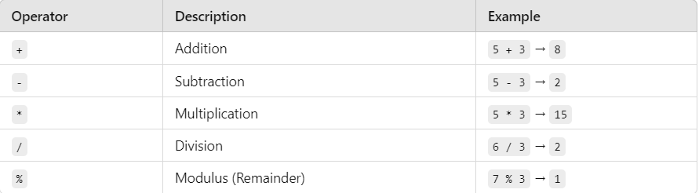
`
Operators in C#
Operators in C# are symbols or keywords that perform operations on variables and values. They are used to manipulate data, perform calculations, compare values, and more. In C#, operators are categorized based on their functionality.
1. Arithmetic Operators
Arithmetic operators perform basic mathematical operations such as addition, subtraction, multiplication, division, and modulus.

Slide 40
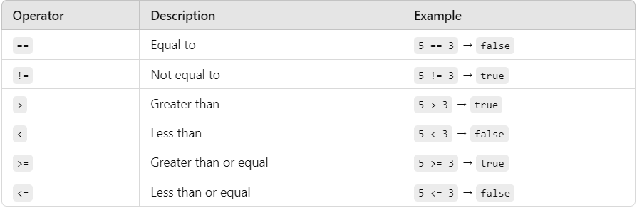
`
Operators in C#
2. Relational (Comparison) Operators
Relational operators compare two values and return a boolean (true or false) based on the comparison.

Slide 41
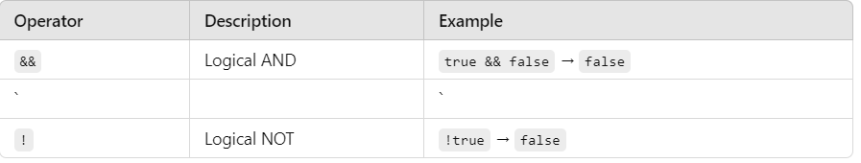
`
Operators in C#
3. Logical Operators
Logical operators are used to combine conditional statements or evaluate boolean expressions.

Slide 42
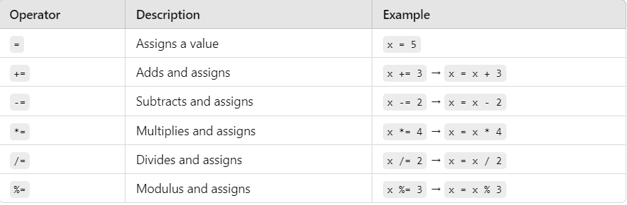
`
Operators in C#
4. Assignment Operators
Assignment operators are used to assign values to variables. The basic assignment operator is =, but C# also supports compound assignment operators, which combine an operation with an assignment.

Slide 43
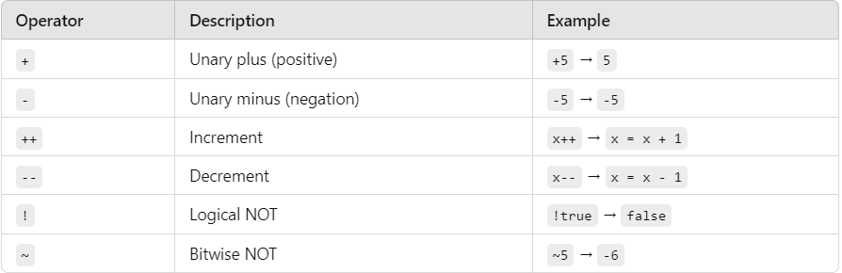
`
Operators in C#
5. Unary Operators
Unary operators operate on a single operand. They are used for operations like incrementing/decrementing a value, negating a value, or converting a boolean.

Slide 44
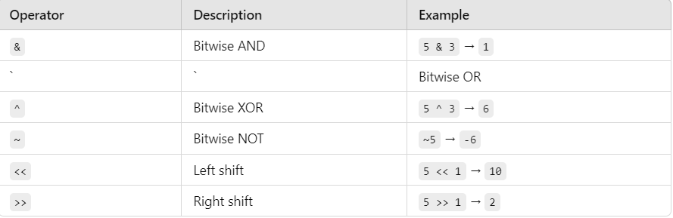
`
Operators in C#
6. Bitwise Operators
Bitwise operators perform operations on the binary representation of integers. These are often used in low-level programming or for tasks like flag manipulation.

Slide 45
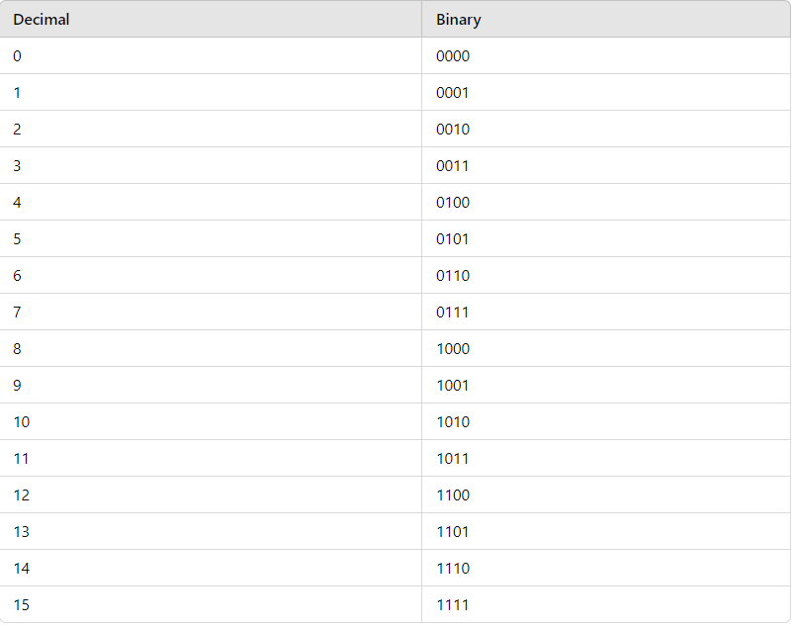
`
Operators in C#
6. Bitwise Operators

Slide 46
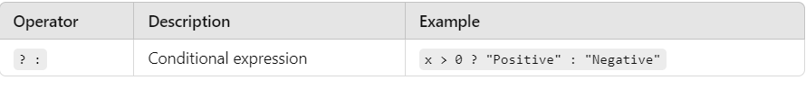
condition ? value_if_true : value_if_false;
Operators in C#
7. Ternary (Conditional) Operator
The ternary operator ? : is a shorthand for an if-else statement. It has the following syntax
condition ? value_if_true : value_if_false;
int x = 10;
string result = x > 0 ? "Positive" : "Negative";
Console.WriteLine(result); // Output: Positive

Slide 47
condition ? value_if_true : value_if_false;
Operators in C#
8. Null Coalescing Operators
These operators help to handle null values in a more concise way.
?? (Null Coalescing Operator)
The ?? operator returns the left-hand operand if it's not null; otherwise, it returns the right-hand operand.
string name = null;
string displayName = name ?? "Guest";
Console.WriteLine(displayName); // Output: Guest
9. ??= (Null Coalescing Assignment Operator)
This operator assigns a value to a variable only if the variable is null.
string name = null;
name ??= "Guest";
Console.WriteLine(name); // Output: Guest

Slide 48
condition ? value_if_true : value_if_false;
Operators in C#
10. Lambda Operator (=>)
The lambda operator is used to define anonymous methods or expressions, especially in LINQ queries.
Func<int, int, int> add = (a, b) => a + b;
Console.WriteLine(add(5, 3)); // Output: 8

Slide 49
condition ? value_if_true : value_if_false;
Conditional statements
In C#, conditional statements allow you to execute certain blocks of code based on whether a specified condition is true or false. There are several ways to implement conditional logic in C#, including:
1. if statement
Syntax:
if (condition)
{
// Code to execute if condition is true
}
int number = 10;
if (number > 0)
{
Console.WriteLine("The number is positive.");
}

Slide 50
condition ? value_if_true : value_if_false;
Conditional statements
2. if-else statement
The if-else statement executes one block of code if the condition is true, and a different block if the condition is false.
if (condition)
{
// Code to execute if condition is true
}
else
{
// Code to execute if condition is false
}
int number = -5;
if (number >= 0)
{
Console.WriteLine("The number is non- negative.");
}
else
{
Console.WriteLine("The number is negative.");
}

Slide 51
condition ? value_if_true : value_if_false;
Conditional statements
3. if-else else-if ladder
You can chain multiple conditions using else if to test several conditions
if (condition1)
{
// Code to execute if condition1 is true
}
else if (condition2)
{
// Code to execute if condition2 is true
}
else
{
// Code to execute if none of the above conditions are true
}

Slide 52
condition ? value_if_true : value_if_false;
Conditional statements
int number = 0;
if (number > 0)
{
Console.WriteLine("The number is positive.");
}
else if (number < 0)
{
Console.WriteLine("The number is negative.");
}
else
{
Console.WriteLine("The number is zero.");
}

Slide 53
condition ? value_if_true : value_if_false;
Conditional statements
4. switch statement
The switch statement allows you to check the value of a variable against a list of possible values. It is often used as an alternative to a large number of if-else statements.
switch (variable)
{
case value1:
// Code to execute if variable == value1
break;
case value2:
// Code to execute if variable == value2
break;
// More cases...
default:
// Code to execute if none of the cases match
break;
}

Slide 54
condition ? value_if_true : value_if_false;
Conditional statements
int day = 3;
switch (day)
{
case 1:
Console.WriteLine("Monday");
break;
case 2:
Console.WriteLine("Tuesday");
break;
case 3:
Console.WriteLine("Wednesday");
break;
case 4:
Console.WriteLine("Thursday");
break;
case 5:
Console.WriteLine("Friday");
break;
case 6:
Console.WriteLine("Saturday");
break;
case 7:
Console.WriteLine("Sunday");
break;
default:
Console.WriteLine("Invalid day");
break;
}

Slide 55
condition ? value_if_true : value_if_false;
Conditional statements
5. Ternary Operator (?:)
The ternary operator is a shorthand for if-else statements. It takes three operands and is useful for simple conditional expressions.
Syntax:
condition ? valueIfTrue : valueIfFalse;
int number = 10;
string result = (number > 0) ? "Positive" : "Non-positive";
Console.WriteLine(result);

Slide 56
condition ? value_if_true : value_if_false;
Conditional statements
6. null-coalescing operator (??)
The null-coalescing operator is used to check if a value is null and provide a default value if it is.
Syntax:
variable ?? defaultValue
string name = null;
string displayName = name ?? "Guest";
Console.WriteLine(displayName); // Output: Guest

Slide 57
condition ? value_if_true : value_if_false;
Conditional statements
7. null-coalescing assignment (??=)
The ??= operator is a shorthand for checking whether a variable is null and assigning a value to it if it is.
Syntax:
variable ??= defaultValue;
string name = null;
name ??= "Guest";
Console.WriteLine(name); // Output: Guest

Slide 58
condition ? value_if_true : value_if_false;
Challenge-1 - If Statements
Create a user Login System, where the user can first register and then Login in. The Program should check if the user has entered the correct username and password, when login in (so the same ones that he used when registering). As we haven't covered storing data yet, just create the program in a way, that registering and logging in, happen in the same execution of it. User If statements and User Input and Methods to solve the challenge.

Slide 59
condition ? value_if_true : value_if_false;
Challenge-2 - If Statements
Create an application with a score, highscore and a highscorePlayer. Create a method which has two parameters, one for the score and one for the playerName. When ever that method is called, it should be checked if the score of the player is higher than the highscore, if so, "New highscore is + " score" and in another line "New highscore holder is " + playerName - should be written onto the console, if not "The old highscore of " + highscore + " could not be broken and is still held by " + highscorePlayer. Consider which variables are required globally and which ones locally.

Slide 60
condition ? value_if_true : value_if_false;
Challenge-3 - Switch
In this task, you are to create a basic calculator using a switch statement that performs arithmetic operations like addition, subtraction, multiplication, and division based on user input. Requirements: 1- The calculator should take two numbers as input.
2- The user should choose an operation from the following:
+ for addition
- for subtraction
* for multiplication
/ for division
3- If the user inputs a character other than these operations, the program should handle it by showing an error message.
4- If the user tries to divide by zero, display an error message.

Slide 61
THANK YOU

